Slide 1
Paying for College
Practical advice to navigate the financial aid process
2019-2020
Jeff Olson
Minnesota Office of Higher Education, Outreach Team since 2010
Bethel University, Director of Financial Aid since 2005

Slide 2
Background – Jeff Olson
Worked in college financial aid office since 1994
President of MN Association of Student Financial Aid Administrators 2003-04
Director of financial aid at Bethel since 2005
MN Office of Higher Education Outreach Team since 2010-11
172 financial aid training events (prior to fall 2018)
  35 different high schools
  21 elementary or middle schools, agencies, businesses, school districts
Married with four kids; together we’ve attended 11 different post-secondary schools
Public
  Anoka-Ramsey Community College, MN
  Southwest Missouri State University, MO
  University of Minnesota Twin Cities, MN
  Private
      Alliance Theological Seminary, NY
      Bethel University, MN
      Concordia College, Moorhead, MN
      Crown College, MN
      Houghton College, NY
      Nyack College, NY
      PACE University, NY
      University of St. Thomas, MN

Slide 3
Paying for College Agenda
How much does college cost?
Is postsecondary education worth the investment?
How will I pay for college?
What is financial aid?
How do I apply for financial aid?
Where can I find answers to more questions?
Questions

Slide 4
Colleges & Universities
Degree-granting and eligible for federal financial aid programs
Type of Institution
4-Year Public
2-Year Public
4-Year Private Nonprofit
2-Year Private Nonprofit
4-Year Private For-profit
2-Year Private For-profit
Total
 | # of Schools (2015-2016)
Type of Institution | U.S. | Minnesota
4-Year Public | 710 | 12
2-Year Public | 910 | 31
4-Year Private Nonprofit | 1,594 | 35
2-Year Private Nonprofit | 107 | 1
4-Year Private For-profit | 562 | 34
2-Year Private For-profit | 700 | 2
Total | 4,583 | 115
 | # of Schools (2015-2016) |  | Minnesota Examples with Fall 2016 Undergraduate Enrollment
Type of Institution | U.S. | Minnesota
4-Year Public | 710 | 12 | University of Minnesota-Twin Cities | 34,870
2-Year Public | 910 | 31 | Minneapolis Community and Technical College | 7,982
4-Year Private Nonprofit | 1,594 | 35 | University of St Thomas | 6,048
2-Year Private Nonprofit | 107 | 1 | White Earth Tribal and Community College | 77
4-Year Private For-profit | 562 | 34 | Capella University | 9,393
2-Year Private For-profit | 700 | 2 | Le Cordon Bleu College of Culinary Arts | 156
Total | 4,583 | 115
SOURCE: U.S. Department of Education, National Center for Education Statistics, Integrated Postsecondary Education Data System (IPEDS), Fall 2015, Institutional Characteristics component. (This table was prepared November 2016.) Table 317.20 Degree-granting postsecondary institutions, by control and classification of institution and state or jurisdiction: 2015-16, retrieved October 15, 2017 from https://nces.ed.gov/programs/digest/d16/tables/dt16_317.20.asp?current=yes. Fall 2016 enrollment retrieved from https://nces.ed.gov/collegenavigator on October 15, 2017.

Slide 5
Average Annual Expense for a Resident Undergraduate Attending Full-Time at a Minnesota College, 2017-2018
SOURCE (retrieved 09/24/2018): www.ohe.state.mn.us/mPg.cfm?pageID=94

Slide 6
Average Tuition and Fees: 2018-2019
SOURCE: MN Office of Higher Education, Minnesota Tuition & Fees 2017-2018, http://www.ohe.state.mn.us/sPages/TuitionChart.cfm?SchState=MN&pageID=651, data retrieved 11.3.2017, calculations by author.

Slide 7
Attending Public College Outside of MN? Tuition Reciprocity can reduce costs
Allows MN residents to attend in neighboring states at rate similar to MN resident rate
Students need to apply (some assume it’s automatic)
  Some students apply to college, some apply online (beginning March 1 for fall term), details at https://www.ohe.state.mn.us/ssl/reciprocity/apply1.cfm
Midwestern Student Exchange Program
  Reduced rates for MN residents attending select schools in Illinois, Indiana, Kansas, Michigan, Missouri, Nebraska
Reciprocity Details: http://www.ohe.state.mn.us/mPg.cfm?pageID=120
Notes:
Online Tuition Reciprocity Application
Affordable education in other states, because you live in Minnesota
Complete this online application if you are a Minnesota resident and are attending a public college or university in:
Wisconsin (UW campuses only) or North Dakota.
The online application is the easiest way to apply for reciprocity benefits. Paper applications are also available.
Stop! This application is not applicable if you are a Minnesota resident and enrolled in:
A distance education program at a college in a neighboring reciprocity state while remaining in Minnesota.
A state college or university in South Dakota. South Dakota will determine your eligibility for reciprocity benefits determined by the campus you attend.
A public technical college in South Dakota or Wisconsin. You need to apply directly to the technical college for tuition reciprocity benefits because those colleges do not use this web-based application.
Manitoba, Iowa or any of the states participating in the Midwestern Student Exchange Program (MSEP)--Kansas, Michigan, Missouri or Nebraska. You should apply directly to the college for reduced tuition benefits because those colleges do not use this web-based application.
A program charging the same tuition rate to all students regardless of state of residence.
A private college. They do NOT participate in the tuition reciprocity program because they do not charge non-resident tuition rates.

Slide 8
Tuition Reciprocity Example: University of Wisconsin, Madison
2018-19 Tuition & Segregated Fees per semester
  Fall 2018
  undergraduate students)
SOURCE: https://registrar.wisc.edu/tuitionrates/, retrieved September 24, 2018

Slide 9
Paying for College Agenda
How much does college cost?
Is postsecondary education worth the investment?
How will I pay for college?
What is financial aid?
How do I apply for financial aid?
Where can I find answers to more questions?
Questions

Slide 10

Educational Investments Worth It!
“By 2020, 65% of all jobs will require postsecondary education.”
For most jobs, securing a high school education will not be enough to qualify for employment.
Applicants will need to have some form of post-secondary education:
  Bachelor’s Degree or beyond
  Some college / AA degree
  Certificate or certification in a field
  Anthony Carnevale, Georgetown University, Center on Education and the Workforce
SOURCE: Carenevale, Anthony P, Nichole Smith, and Jeff Strohl, Recovery: Job Growth and Education Requirements through 2020, June 26, 2013, Georgetown University Center on Education and the Workforce. Retrieved on October 17, 2017, from https://cew.georgetown.edu/cew-reports/recovery-job-growth-and-education-requirements-through-2020/#powerpoint
Notes:
The growth of U.S. jobs and wages during the recovery is analyzed in Good Jobs Are Back: College Graduates Are First in Line. The findings show that since 2010, the economy has produced 6.6 million employment opportunities. Out of these career opportunities, 2.9 million are considered good jobs. The key finding revealed that 2.8 million good jobs went to college graduates. Some of the largest growing professions seek high-skilled workers and offer large benefits packages. Most good jobs are full time and twice as likely to provide health insurance and retirement plans. The competitive wages and good benefits of these good jobs offer created a healthy job market during the recovery.
Key Findings
Benefits
Eighty-six percent of workers in good jobs are full-time; 68 percent of good jobs provide health insurance; and 61 percent of good jobs include an employer-sponsored retirement plan.
Occupations
Managers, STEM (science, technology, engineering, and mathematics) and healthcare professionals account for the majority of growth in the good jobs tier.
Middle-wage Jobs
Middle-wage jobs have not fully recovered, remaining 900,000 jobs below their pre-recession employment levels.
Low-wage Jobs
Low-wage jobs pay $32,000 or less but comprise only 27 percent (1.8 million) of the jobs added after the recession.

Slide 11
Unemployment rates and earnings by educational attainment: 2017
Note: Data are for persons age 25 and over. Earnings are for full-time wage and salary workers.
Source: Current Population Survey, U.S. Department of Labor, U.S. Bureau of Labor Statistics, last modified March 27, 2018, retrieved on September 24, 2018, from https://www.bls.gov/emp/chart-unemployment-earnings-education.htm
Notes:
IPEDS Glossary (https://surveys.nces.ed.gov/ipeds/VisGlossaryAll.aspx). A first-professional degree was an award that required completion of a program that met all of the following criteria: (1) completion of the academic requirements to begin practice in the profession; (2) at least 2 years of college work prior to entering the program; and (3) a total of at least 6 academic years of college work to complete the degree program, including prior required college work plus the length of the professional program itself. First-professional degrees may be awarded in the following 10 fields:
Chiropractic (D.C. or D.C.M.)
Dentistry (D.D.S. or D.M.D.)
Law (L.L.B., J.D.)
Medicine (M.D.)
Optometry (O.D.)
Osteopathic Medicine (D.O.)
Pharmacy (Pharm.D.)
Podiatry (D.P.M., D.P., or Pod.D.)
Theology (M.Div., M.H.L., B.D., or Ordination)
Veterinary Medicine (D.V.M.)
Doctor’s degree. The highest award a student can earn for graduate study. The doctor's degree classification includes such degrees as Doctor of Education, Doctor of Juridical Science, Doctor of Public Health, and the Doctor of Philosophy degree in any field such as agronomy, food technology, education, engineering, public administration, ophthalmology, or radiology.

Slide 12
Paying for College Agenda
How much does college cost?
Is postsecondary education worth the investment?
How will I pay for college?
What is financial aid?
How do I apply for financial aid?
Where can I find answers to more questions?
Questions

Slide 13

How America Pays for College
Sallie Mae Survey: 2008 through 2017
  Ipsos conducted survey by telephone during March and April, 2017.
1,600 individuals interviewed for 2017 study:
  800 parents of 18 to 24-year-old undergraduate students, and
  800 18 to 24-year-old undergraduate students.
www.salliemae.com/plan-for-college/how-america-pays-for-college/

Slide 14
Actions Families took in 2016-17 to make college more affordable
SOURCE: Sallie Mae Inc., & Ipsos Public Affairs. (2017). How America Pays for College 2017. Newark, DE. Retrieved from https://www.salliemae.com/research/how-america-pays-for-college

Slide 15
How the Typical Family Pays for College,
Funding Source Share, Year-over-Year
SOURCE: Sallie Mae Inc, & Ipsos Public Affairs. (2017). How America Pays for College 2017. Newark, DE. Retrieved from https://www.salliemae.com/research/how-america-pays-for-college
Notes:
After combining groups, the distribution of resources was as follows:
• Family income and savings (parent and student combined) contributed the largest share of college funding, 41 percent.
• External aid—the combination of scholarships and grants, and contributions from relatives and friends—funded a slightly smaller share, 39 percent.
• Borrowed money—student and parent loans combined— covered 20 percent of college costs

Slide 16
Paying for College Agenda
How much does college cost?
Is postsecondary education worth the investment?
How will I pay for college?
What is financial aid?
How do I apply for financial aid?
Where can I find answers to more questions?
Questions

Slide 17

Types of Financial Aid
Grants
Scholarships
Loans
Student Employment

Slide 18
2015-2016 Grants and Scholarships Awarded to Undergraduates at Minnesota Institutions ($1.51 BILLION) – Funding Source
Private
  $72.0 million (5%)
State
  $219.9 million (15%)
Federal
  $391.5 million (26%)
Colleges and Universities
  $825.3 million (55%)
Source: MN Office of Higher Education, Financial Aid awarded to Undergraduates at Minnesota Institutions,
http://www.ohe.state.mn.us/sPages/FaaReport.cfm?report=all, retrieved September 24, 2018.
Notes:
http://www.ohe.state.mn.us/sPages/FaaReport.cfm?report=all
Grant & Scholarship Programs
Aid year 2014-2015
MN State Grant Program $176,893,000
MN GI Bill $1,002,272
MN Indian Scholarships $3,137,525
MN Post-Secondary Child Care $5,766,787
MN Safety Officer Survivor Suppressed
Local and State Agency Grants $32,808,575
Federal Pell Grants $410,508,355
Federal SEOG Awards $19,346,264
Federal Agency Grants $7,719,386
Institution Grants $726,954,574
Institution Tuition Discounts $54,126,526
Private Grants $66,218,283
Other Grants $3,181,906
Total Grants $1,507,712,055

Slide 19
Paying for College Agenda
How much does college cost?
Is postsecondary education worth the investment?
How will I pay for college?
What is financial aid?
How do I apply for financial aid?
  MN Dream Act
  FAFSA
  Professional Judgment Adjustments to FAFSA data
Where can I find answers to more questions?
Questions

Slide 20

MN Dream Act for Minnesota’s Undocumented Students
Qualifying undocumented students eligible for:
  In-state tuition rates at Minnesota State and U of MN
  State financial aid programs
    State Grant, Child Care Grant, Teacher Candidate Grant, Occupational Grant, Dual-training Grant, MN SELF Loan, MN Work Study (while authorized to work in US, until DACA expires), SELF Loan
  Private scholarships administered by public institutions
To meet MN Dream Act requirements:
  Attend MN high school for at least 3 years
  Graduate from a MN high school or earn MN GED
  Comply with Selective Service requirements
  Apply for lawful immigration status once a federal process for doing so exists (not yet applicable)
Apply online: www.ohe.state.mn.us/MNDreamAct
Notes:
http://www.ohe.state.mn.us/mPg.cfm?pageID=2056
MN Dream Act State Financial Aid Instructional Video available at MN College Goal website: “FAFSA / Site Coordinator Training Sessions” http://minnesotacollegegoal.org/FAFSATraining.html
UPDATE 9/5/2017: President Trump directed the U.S. Department of Homeland Security (DHS) and U.S. Citizenship and Immigration Services (USCIS) to phase out and eventually end Deferred Action for Childhood Arrivals (DACA). The Minnesota Dream Act remains intact. One benefit of the Minnesota Dream Act is access to the Minnesota State Work Study program; students are required to document eligibility to work in the U.S. in order to utilize this program. DACA recipients may continue to utilize Minnesota Work Study until their work authorization expires. The MN Dream Act remains in place for Minnesota students who qualify. This includes access to the Minnesota State Grant, Minnesota Childcare Grant, Teacher Candidate Grant, Occupational Grant, Dual-Training Grant, Minnesota SELF Loan, in-state tuition rates and privately funded financial aid through public colleges and universities.

Slide 21
Common Financial Aid Applications
CSS Profile
FAFSA
College Board
About 400 colleges and scholarship programs
https://cssprofile.collegeboard.org
Free Application for Federal Student Aid
All schools participating in federal financial aid programs
Used to determine eligibility for…
  Federal Pell Grant
  Minnesota State Grant
  Federal Student Loans
  Federal Parent (PLUS) Loan
  Other
Fafsa.gov

Slide 22
Filling out the FAFSA – READ THIS FIRST studentaid.ed.gov/sa/fafsa/filling-out
Creating Federal Student Aid (FSA) ID
Gathering documents needed to complete FAFSA
Getting help completing FAFSA
Starting your FAFSA Form
Listing Colleges and/or Career Schools on FAFSA
Determining student’s Dependency Status
Reporting Parents’ Information
Providing Financial Information
  What to do if your parents’ marital status changed since taxes were filed
  Automatically transferring your tax information using IRS Data Retrieval tool
Signing and Submitting FAFSA form

Slide 23
Part 1
FAFSA Filing Options:
https://studentaid.ed.gov/sa/fafsa/filling-out
Notes:
Note to Presenter: This presentation provides information on the FSA ID that can be used in outreach to students and parents. The presentation was created by Federal Student Aid, an office the U.S. Department of Education. You may add or delete content to/from it. However, you must ensure that any edits made to this presentation and/or any uses of this presentation are done in a manner that furthers the goals of the Department. [This presentation was produced in November 2015.]

Slide 24
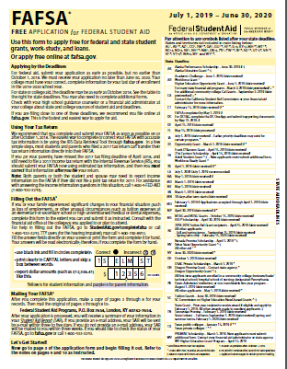
4 FAFSA Filing Options
2019-2020
Log in at fafsa.gov to apply online or
Fill out the form in the myStudentAid mobile app, available on the App Store (iOS) or Google Play (Android) or
Complete a 2018–19 FAFSA PDF or a 2019–20 FAFSA PDF (note: you must print out and mail the FAFSA PDF for processing) or
Request a print-out of the FAFSA PDF by calling us at 1-800-4-FED-AID (1-800-433-3243) or 334-523-2691 (TTY for the deaf or hard of hearing 1-800-730-8913); then fill out the form and mail it for processing
https://studentaid.ed.gov/sa/fafsa/filling-out

Slide 25
When to submit FAFSA?
Advice from Minnesota Financial Aid Administrators
Minnesota’s FAFSA Deadline is “30 days after term starts”
Question: When do you recommend that high school seniors, who will graduate from high school in the spring of 2018, submit their 2018-19 FAFSA (assuming they are only applying to your institution)? 19 Respondents
SOURCE: Email survey of members of the Minnesota Association of Financial Aid Administrators, October 2017, 19 respondents out of 140 colleges and universities reporting to IPEDS.

Slide 26
Part 2
Creating Your FSA ID:
Notes:
Note to Presenter: This presentation provides information on the FSA ID that can be used in outreach to students and parents. The presentation was created by Federal Student Aid, an office the U.S. Department of Education. You may add or delete content to/from it. However, you must ensure that any edits made to this presentation and/or any uses of this presentation are done in a manner that furthers the goals of the Department. [This presentation was produced in November 2015.]

Slide 27
FSA ID Overview
The FSA ID is a username and password used by students, parents, and borrowers to:
    login to U.S. Department of Education websites
    electronically sign documents
    Apply online at Go to https://fsaid.ed.gov
Must have FSA ID to use myStudentAid mobile app:
Parents and Students will use it sign FAFSA and apply for federal student loan(s)
  Must have
  Password Expires every 18 months

Slide 28
Tips when creating Your FSA ID
When to apply for Your FSA ID?
Either at least 3 business before submitting FAFSA, or
When you begin your FAFSA
E-mail:
Each FSA ID must have a unique e-mail address (you and your parent cannot use the same e-mail address)
  You can use your e-mail to get your username and password
  You can use your verified e-mail address instead of username

Slide 29
Tips when creating Your FSA ID
When to apply for Your FSA ID?
Either at least 3 business before submitting FAFSA, or
When you begin your FAFSA
Is a Social Security Number required for FSA ID?
Yes. If your parent doesn’t have a Social Security number (SSN), your parent won’t be able to create an FSA ID (which requires an SSN). This means you’ll have to select the option to print a signature page when you get to the end of your FAFSA form.
Enter Student’s FSA ID when beginning FAFSA

Slide 30
Should parents create FSAID for their children? No
“I understand that I will be required to certify that the information that I provide to obtain an FSA ID is true and correct and that I am the individual who I claim to be. If I am not that person who I claim to be, I understand that I am not authorized to proceed and that I should exit this form now. If I provide false or misleading information, I understand that I may be fined, sent to prison for not more than five years, or both.” (https://fsaid.ed.gov/npas/reg/pin_lookup.htm)

Slide 31
Part 3
FAFSA on the Web Tips

Slide 32
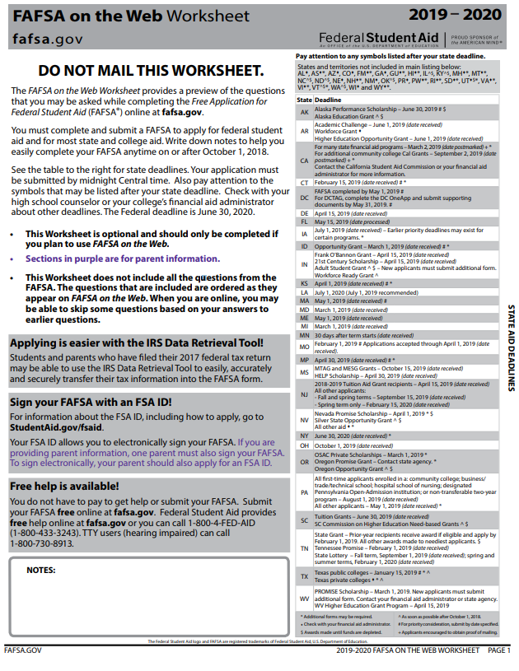
Documents needed when completing FAFSA
Social Security number for student and parents (if dependent)
Student’s driver’s license number (if you have one)
Your Alien Registration number if you are not a U.S. citizen
Federal tax information or tax returns including IRS W-2 information, for you (and your spouse, if you are married), and for your parents if you are a dependent student:
  IRS 1040, 1040A, 1040EZ or Foreign tax return or Tax return for Puerto Rico, Guam, American Samoa, the U.S. Virgin Islands, the Marshall Islands, the Federated States of Micronesia, or Palau
Records of your untaxed income, such as child support received, interest income, and veterans noneducation benefits, for you, and for your parents if you are a dependent student
Information on cash; savings and checking account balances; investments, including stocks and bonds and real estate (but not including the home in which you live); and business and farm assets for you, and for your parents if you are a dependent student
RESOURCE: 2019-20 FAFSA on the Web Worksheet (https://studentaid.ed.gov/sa/sites/default/files/2019-20-fafsa-worksheet.pdf)

Slide 33
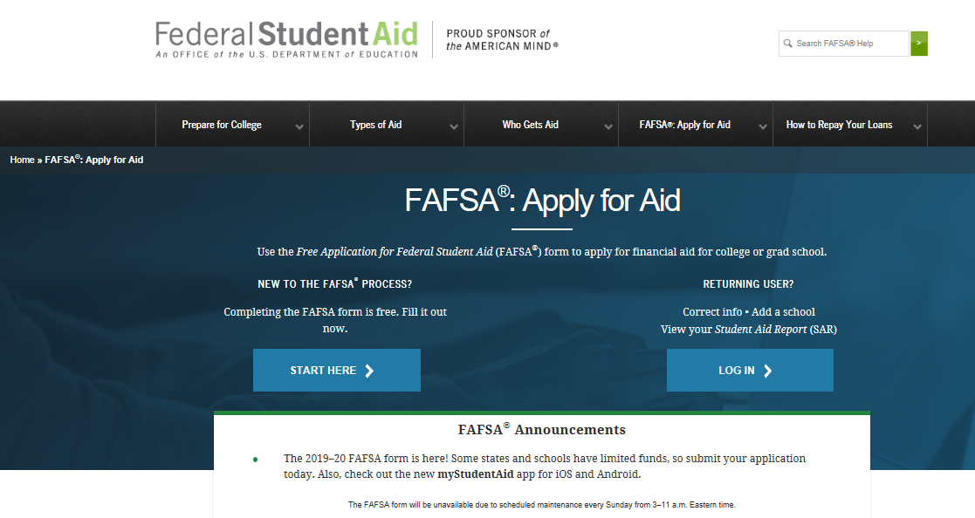
Notes:
The next screen shows us the FAFSA “Home” page. Notice that it looks exactly like the live FAFSA site. And it performs just like the live site too, with the exceptions that I mentioned earlier. If you want to test an initial FAFSA experience, click on Start a New FAFSA. If you want to use our preloaded data to make a correction, add a school, or something like that, click on Login.

Slide 34
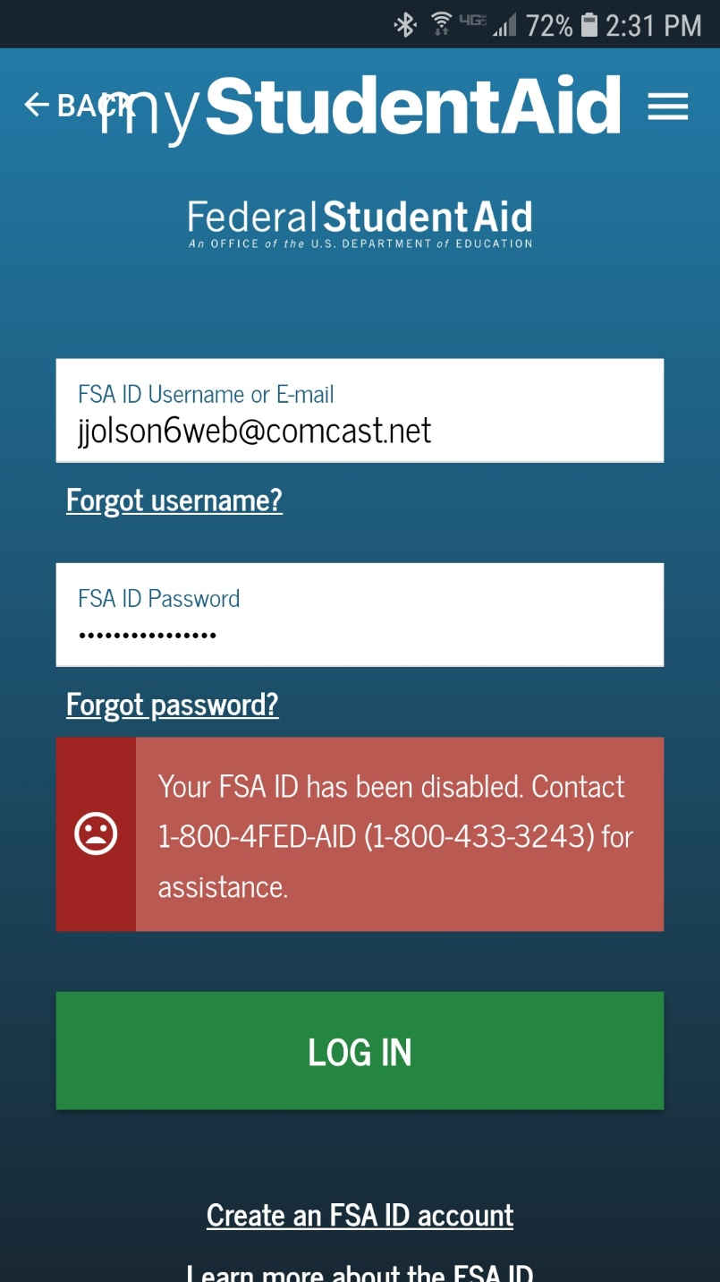
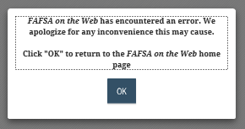
Unable to login to FAFSA.gov?
May be technical problem on website
Early October – FAFSA.gov intermittent functionality
Oct 7, 2018
  I was unable to login using MyStudentAid app on my phone. Messaging looked like my userid and/or password was wrong.
  I was unable to login at FAFSA.gov (2:30 pm central time); generic error message
  After 3 attempts, my FSA ID was disabled
Oct 9, 2018
  Reset my FSA ID online – 5 minutes
  Completed FAFSA using myStudentAid phone app – 10 minutes

Slide 35
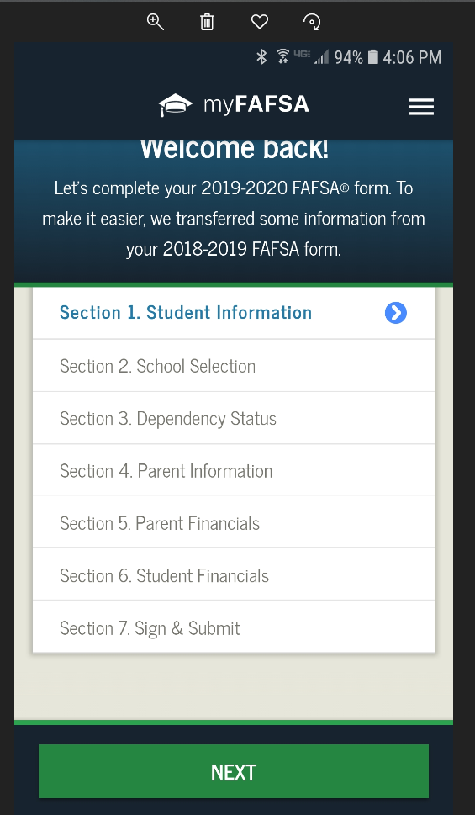
Mobile FAFSA Tips
Enable cookies to avoid issues
If doing FAFSA on your phone, use the FAFSA app. The FAFSA app currently works better than navigating FAFSA.gov on a browser on your phone.
The FAFSA App includes IRS Data Retrieval
Student and parent cannot be working on FAFSA App at the same time. Students should sign and log out and then parent should sign

Slide 36
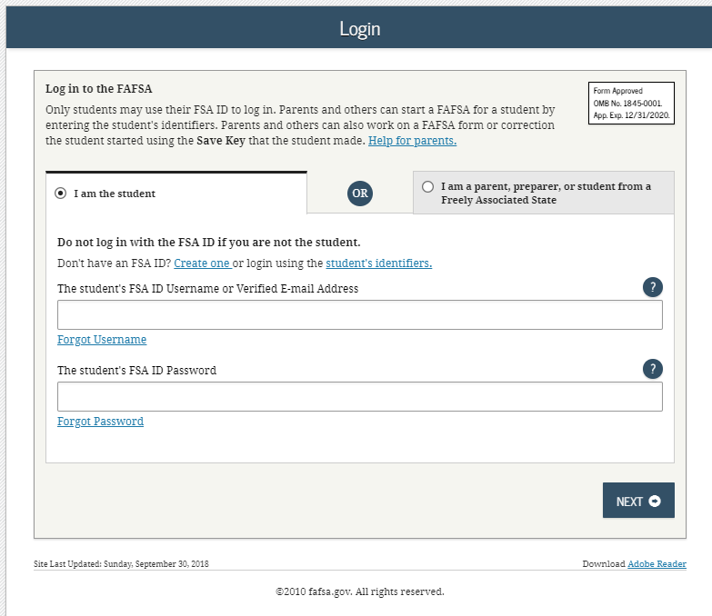
Notes:
This is the “Login” landing page. Because the FAFSA is ALWAYS the student’s application (rather than the parent’s), the student inputs his or her information first. The personal identifying information entered here will form the record locators within the FAFSA database.

Slide 37
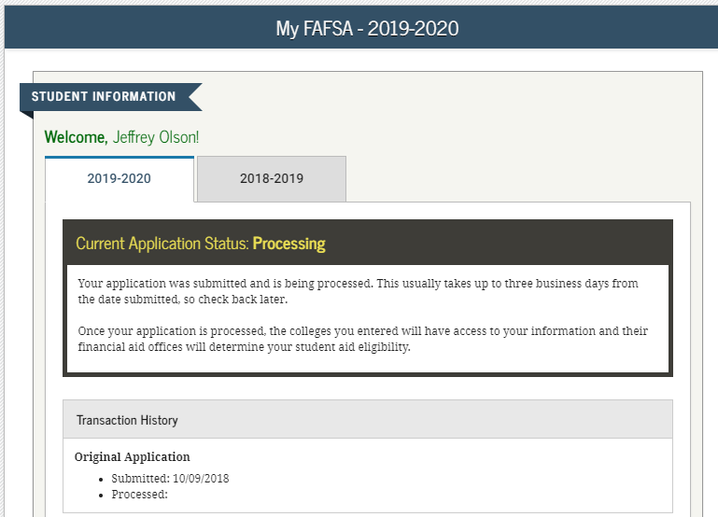
Notes:
Now that Melanie has established a FAFSA record, she can designate which FAFSA she wants to access: the 2015-2016 FAFSA or the 2014-2015 FAFSA. Note the verbiage to the left that helps students determine which FAFSA they need to complete for the academic year in which they want to receive financial aid for. We’ll have Melanie click the Start 2015-2016 FAFSA option.
*Note, because Melanie has not created an FSA ID, Melanie should click on the link Create an FSA ID so she can electronically sign her FAFSA.

Slide 38
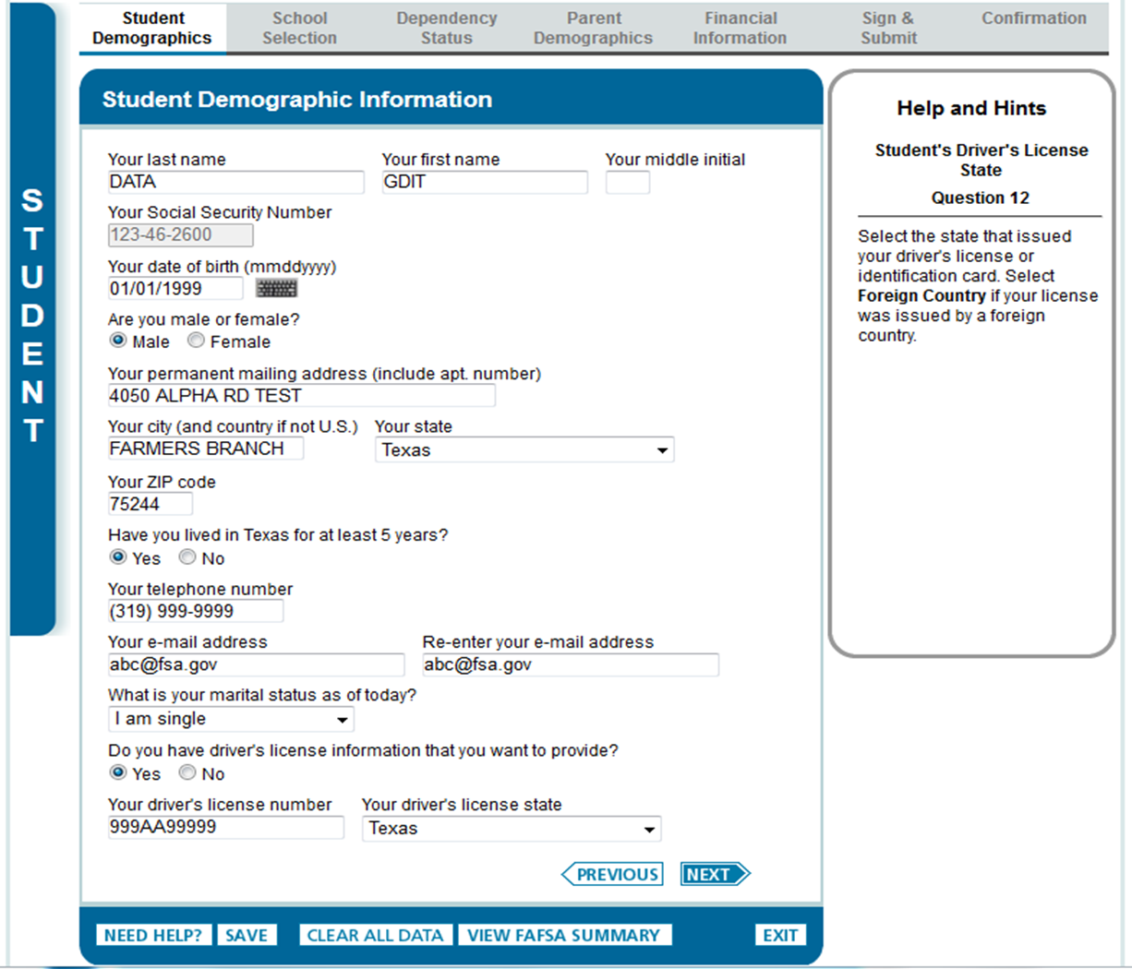
Notes:
Now Melanie will begin providing personal information about herself. Notice along the top of this page are tabs designating the different sections of the FAFSA: Student Demographics, School Selection, Dependency Status, Parent Demographics, Financial Information, Sign and Submit, and Confirmation.

Slide 39
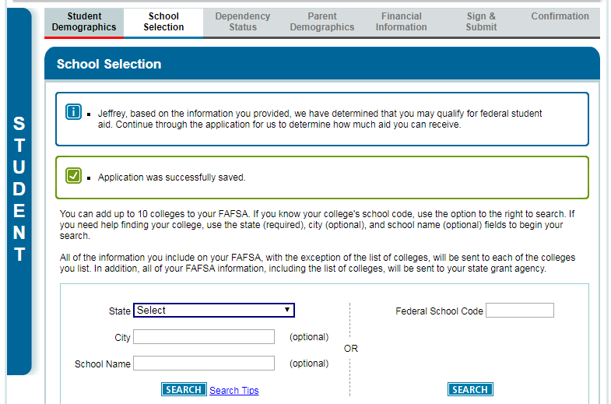
Add up to 10 schools to FAFSA
(must have at least 1 school)
Notes:
Notice that we have moved to the second tab: School Selection. This section begins by informing Melanie that she may qualify for federal aid based upon the information she has input so far. Next, she will designate which schools she wants to receive her processed FAFSA data. She must list one, and can list up to ten.

Slide 40
Student Dependent if “no” to all of the following questions
Age 24+. Born before January 1, 1996?
Married. Married as of today?
Graduate Student. Working on master’s or doctorate program at beginning of 2019-2020 school year?
Military. Currently active duty U.S. Armed Forces (other than training)
Veteran. Veteran of U.S. Armed Forces
Parent. Have (or will have) children who will receive more than half of their support from student between July 1, 2018 and June 30, 2020?
Orphan/Ward of Court. At any time since you turned age 13, were both your parents deceased, were you in foster care or were you a dependent or ward of the court?
Other Dependents. Do you have dependents (other than your children or spouse) who live with you and who receive more than half of their support from you, now and through June 30, 2020?
Legally emancipated minor. As determined by a court in your state of legal residence, are you or were you an emancipated minor?
Legal Guardianship. Does someone other than your parent or stepparent have legal guardianship of you, as determined by a court in your state of legal residence?
Homeless. At any time on or after July 1, 2018, did your high school or school district homeless liaison determine that you were an unaccompanied youth who was homeless or were self-supporting and at risk of being homeless?
Unaccompanied Youth. At any time on or after July 1, 2018, did the director of an emergency shelter or transitional housing program funded by the U.S. Department of Housing and Urban Development determine that you were an unaccompanied youth who was homeless or were self-supporting and at risk of being homeless?
Unaccompanied Youth. At any time on or after July 1, 2018, did the director of a runaway or homeless youth basic center or transitional living program determine that you were an unaccompanied youth who was homeless or were self-supporting and at risk of being homeless?
(2019-2020 FAFSA)

Slide 41
Parents’ Info on FAFSA
Parents unmarried but living together
Beginning with 2014-2015, Dependent student will report information about both legal (biological or adoptive) parents if the parents are living together, regardless of the parents’ marital status or gender
  Previously, student only reported information about one parent (typically, custodial parent) if not married
New response added to parents’ marital status – ‘Unmarried and both parents living together’

Slide 42

Providing Parents’ Information on FAFSA
Married. If biological/adoptive parents married, report information for both parents
Divorced or Separated. If biological/ adoptive parents are divorced or separated, provide information for parent:
  Student lived with the most in last year
  Or, if lived equal periods with each parent, parent who provided the most financial support in last year or most recent year support provided
    If that parent remarried, include stepparent’s information, even if stepparent did not adopt student
  Note: Unlike FAFSA, CSS Profile form will require information for non-custodial parent

Slide 43

Providing Parents’ Information on FAFSA
Single or Widowed. If biological/adoptive parent is single or widowed, provide information about surviving parent
Remarried. If surviving parent remarried, include stepparent’s information, even if stepparent did not adopt student

Slide 44

Providing Parents’ Information on FAFSA
Others filling role of parents
  Grandparents, foster parents, other relatives and legal guardians are NOT considered parents on the FAFSA unless they legally adopted student
    Do NOT substitute information about above parties in parent section on FAFSA

Slide 45
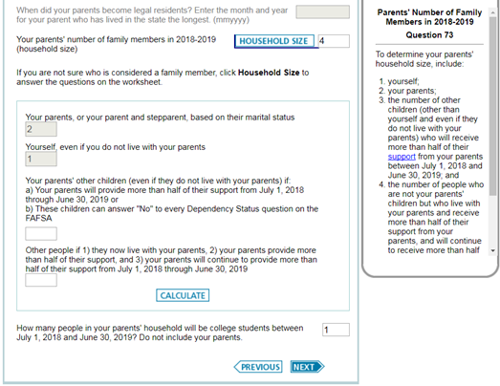
Household size & # in College
Household
  Parent(s)?
  Student
  Other children?
  Other people?
# in College
  Does not include parent(s)
Notes:
Because Melanie was determined to be dependent, we move to the fourth tab: Parental Information. Notice the color change!! We want to make sure students and parents can easily determine their sections of the FAFSA not only by the designated tabs, but also by the color. On this page, Melanie (along with her parents) enters the parental demographic information.

Slide 46
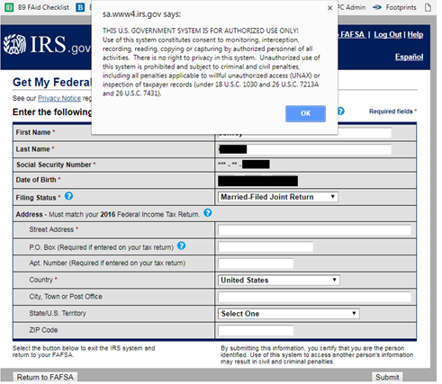
Notes:
Warning text appears as the 2017-18 IRS DRT site is displayed.

Slide 47
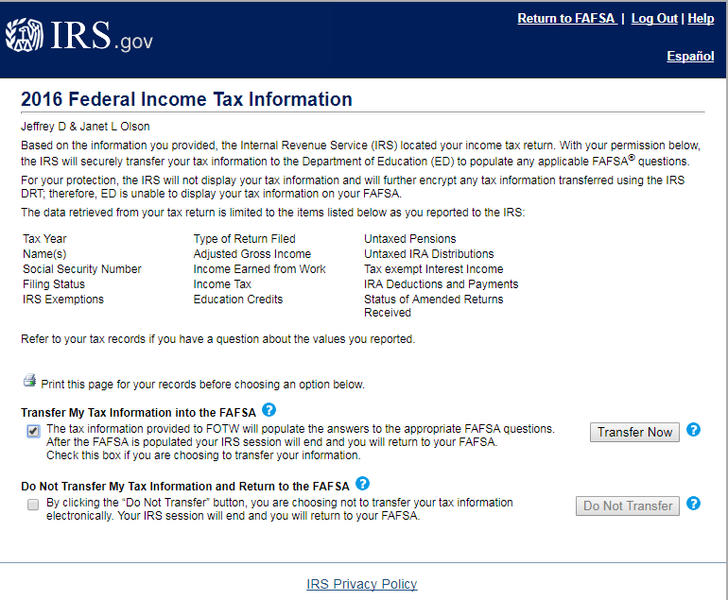
Authorize Transfer
Check “Transfer My Tax Info” box
Click “Transfer Now”
Notes:
2017-18 IRS Data Retrieval Tool, page 2, containing user-specific IRS data.
The user can check the “Transfer My Tax Information…” box and click “Transfer Now” to carry this data back into FOTW.
The user can check the “Do Not Transfer…” box and click “Do Not Transfer” to discontinue use of the IRS DRT and return to FOTW.
The user can click the “Print this page” icon in order to print the data that is displayed on this page.

Slide 48
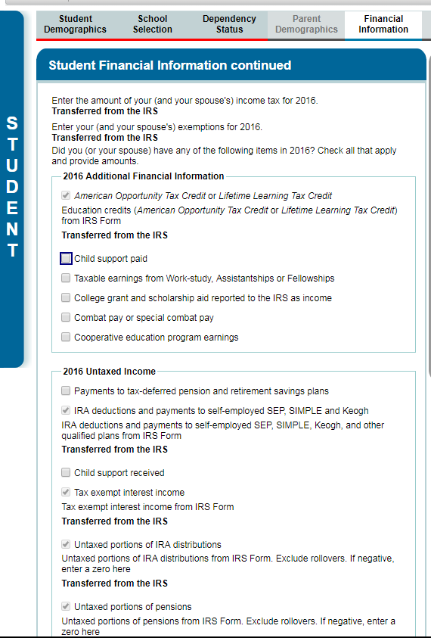
Review and edit other financial information
Notes:
This is the top half of the 2017-18 “Parent Financial Information continued” page. The bottom half of the page is continued on the next slide.
The “Additional Financial Information” section was updated to include “2015” for clarity.

Slide 49
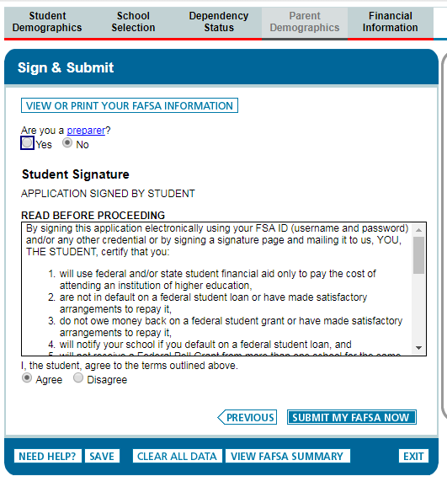
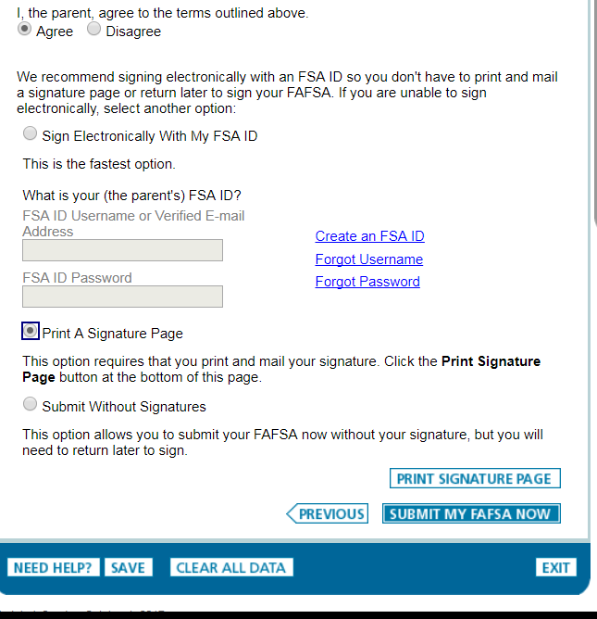
Sign and Submit FAFSA
Notes:
This is the top half of the 2017-18 “Sign & Submit” page, where the student signs and actively acknowledges the Certification Statement. Applicants must still actively agree with the certification statement.
Since the student entered his/her FSA ID to go to the IRS to transfers data, he/she is not requested to provide his/her FSA ID Username and Password again to sign the application.

Slide 50
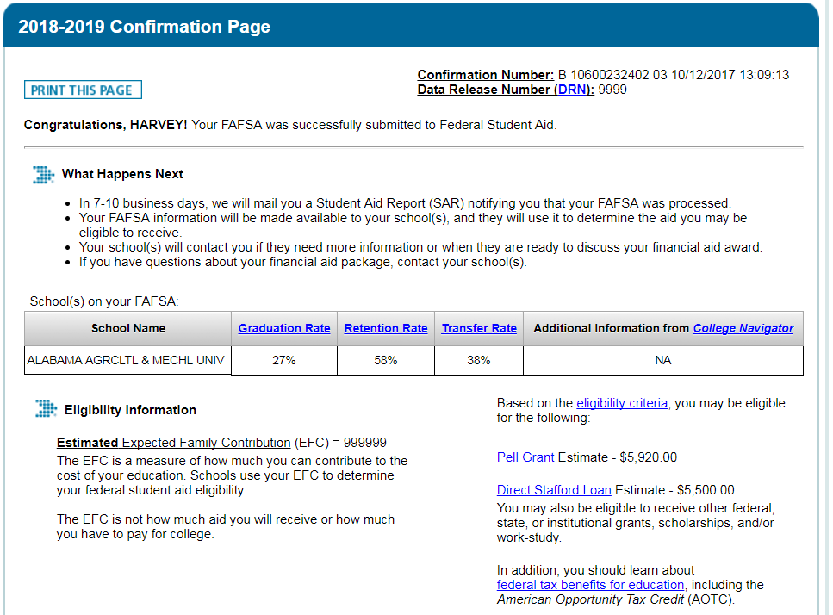
FAFSA Confirmation Page
Notes:
2017-18 “Confirmation Page”
Parents of dependent students are offered the option to transfer the parents’ data into another student’s new FAFSA. The link is found on the “Confirmation Page.”
If the applicant leaves the confirmation page before they click this link they will not be able to return to transfer data to the application of a sibling.

Slide 51

Professional Judgment
Common examples include:
  Significant change in income from past tax year based on unemployment, underemployment, death, divorce, military service or natural disaster
  Unusually high medical expenses
  Nursing home expenses
  Significant college costs for dependent student’s parent attending college
  Dependency override
Family should contact financial aid administrator to discuss unusual circumstances
Notes:
Common examples
Contact each college – apply to each college

Slide 52
Paying for College Agenda
How much does college cost?
Is postsecondary education worth the investment?
How will I pay for college?
What is financial aid?
How do I apply for financial aid?
Where can I find answers to more questions?
Questions

Slide 53


Student Publications
Office of Higher Education
www.ohe.state.mn.us/sPages/pubsGR.cfm

Slide 54
Where to find private scholarships
Research what is available in school, community and parents’ employers
To what organizations and churches does student and family belong?
Application process usually spring of senior year
Small scholarships add up!
  www.finaid.org/scholarships
  Useful Online Resources: https://www.ohe.state.mn.us/mPg.cfm?pageID=1504

Slide 55
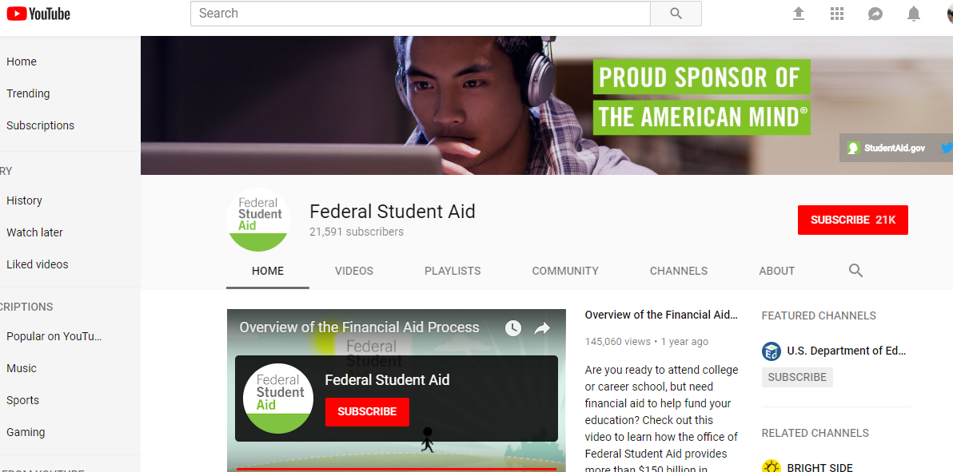
FAFSA Tips
U.S. Department of Education YouTube channel
www.youtube.com/user/FederalStudentAid

Slide 56


Questions?
Jeff Olson
Minnesota Office of Higher Education, Outreach Team
Bethel University, Director of Financial Aid
jeff-olson@bethel.edu

Slide 57

Net Price Calculators
Estimated “Total Cost of Attendance”
Minus estimated “Gift Aid”
= Estimated Net Price
Case Study
  Family of Four
    2 parents
    2 kids
    1 college student
  Minnesota Residents
  Parents’ Adjusted Gross Income Between $50,000-$59,000
Notes:
5

Slide 58
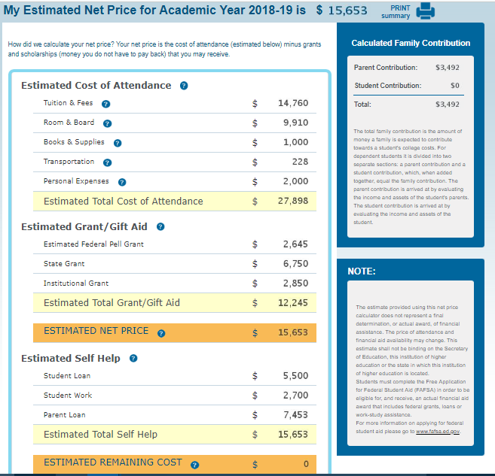
University of Minnesota – Twin Cities
Estimated Price: 2018-2019

Slide 59
Estimated Net Price
MN Dependent student, parents married, 4 in family, 1 in college, AGI Between $50,000-$59,999, Reportable assets <$20,000. Data retrieved 9.24.2018
 | Anoka Ramsey CC (with parents) | U of MN Twin Cities (on-campus) | St. Cloud State Univ. (on-campus) | Harvard University (on-campus) | University of St. Thomas (on-campus)
Year | 2015-16 | 2018-19 | 2016-17 | 2018-19 | 2018-19
HS GPA & ACT | NA | NA | NA | NA | 3.5 & 26
Tuition & Fees | $5,022 | $14,760 | $7,814 | $50,420 | $42,728
Room & Meals | $0 | $9,910 | $7,930 | $17,160 | $10,356
Books & Supplies | $1,200 | $1,000 | $1,200 | NA | $1,000
Other Costs | $6,688 | $2,228 | $2,700 | $4,770 | $2,527
Total Cost of Attendance | $12,910 | $27,898 | $19,644 | $72,350 | $56,600
Gift Aid | $3,438 | $12,245 | $5,775 | $67,750 | $32,277
Estimated Net Price | $9,482 | $15,653 | $13,869 | $4,600 | $24,323
Est. Net Tuition | $1,584 | $2,515 | $2,039 | $(17,330) | $10,451
SOURCES: Search for “Name of School” and “Net Price Calculator” http://www.anokaramsey.edu/cost-aid/net-price-calculator/ https://www.mnscu.edu/admissions/calculator/stcloudstate.html https://college.harvard.edu/financial-aid/how-aid-works/cost-attendance
https://npc.collegeboard.org/student/app/tcumn https://www.stthomas.edu/financialaid/undergraduate/resources/netpricecalculator/

Slide 60
How do parents’ assets impact eligibility for need-based grants? It Depends…
Net Price Calculator Simulation: Family of 4, MN residents, 2 parents, 1 college freshman. student, attending University of Minnesota Twin Cities for 2018-19 as new freshman.
Parents’ Adjusted Gross Income | Parents’ Cash, Savings & Checking | FAFSA Expected Family Contribution | Estimated Cost of Attendance | Simulated Total Gift Aid | Simulated Net Price
$50,000 | $0 | $2,531 | $27,152 | $12,820 | $14,332
$50,000 | $50,000 | $3,289 | $27,152 | $11,920 | $15,232
Change | +$50,000 | +758 | $0 | -$900 | +$900
Parents’ Adjusted Gross Income | Parents’ Cash, Savings & Checking | FAFSA Expected Family Contribution | Estimated Cost of Attendance | Simulated Total Gift Aid | Simulated Net Price
$50,000 | $0 | $2,531 | $27,152 | $12,820 | $14,332
$50,000 | $50,000 | $3,289 | $27,152 | $11,920 | $15,232
Change | +$50,000 | +758 | $0 | -$900 | +$900
$100,000 | $0 | $16,987 | $27,152 | $0 | $27,152
$100,000 | $50,000 | $18,605 | $27,152 | $0 | $27,152
Change | +$50,000 | +1,618 | $0 | $0 | $0
SOURCE: https://npc.collegeboard.org/student/app/tcumn, data retrieved October 24, 2017

